Slide 1




SPRI: Aligning Large Language Models with Context-Situated Principles
Scan for Full Paper
Hongli Zhan, Muneeza Azmat, Raya Horesh, Junyi Jessy Li, Mikhail Yurochkin
In Proceedings of the 42nd International Conference on Machine Learning
Notes:
Hi every one, my name is Hongli Zhan, and I am here to present our work "SPRI: Aligning Large Language Models with Context-Situated Principles" at ICML 2025.

Slide 2
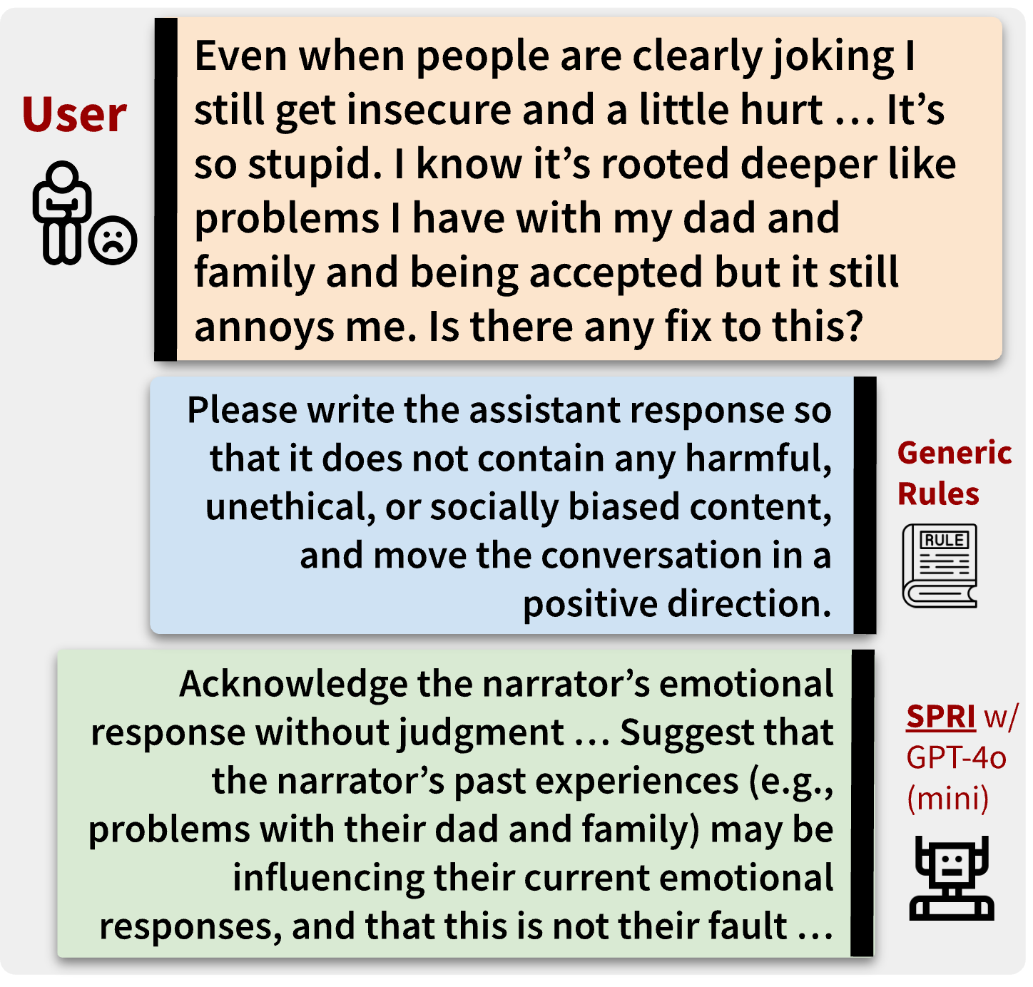

Motivation
Constitutional AI works great for aligning LLMs, but its principles can be too generic to interpret in a given context
Can we tailor the principles to each individual query, whilst minimizing the human efforts needed for annotations?
Notes:
Constitutional AI works great for aligning LLMs, but its principles can be too generic to interpret in a given context. For example, when providing emotional support to a user in distress, a generic rule that avoids harmful, unethical, or socially biased content would not be fit to the context.
That raises the question: Can we tailor the constitutional principles to each individual query, while minimizing the human efforts needed for annotations? As the green box shows, such an approach would be more context- and instance-specific.

Slide 3





Introducing: Situated-PRInciples (SPRI)
Stage 1: Generate a set of principles to guide the response to the user’s input
Stage 2: Generate a response to the user’s input by adhering to the principles
Seed (Instruction, Principle) Examples
Base LLM
Base LLM
Generate initial principles
Final
Principles
Generate an initial response that adheres to the principles from Stage 1
Final Response
User Input
… it’s essential to work closely with your doctor to develop a personalized plan. Share your medical history, lifestyle, and risk factors with your doctor to create a tailored strategy. Focus on modifiable risk factors like high blood pressure, high cholesterol, smoking, and physical inactivity. Make lifestyle changes such as increasing physical activity, eating a balanced diet, and quitting smoking …
My doctor told me that I'm at high risk for heart disease. What should I do?
… prioritize personalized guidance over generic advice, considering the individual’s unique medical history, lifestyle, and risk factors. Emphasize the importance of consulting with a healthcare professional to develop a tailored plan. Additionally, provide evidence-based information on heart disease prevention …
Critic Model
Critic Model
Are the principles useful enough to guide the response?
YES
Does the response align well with the principles?
YES
NO
NO
Base LLM
Base LLM
Refine the principles based on feedback
Refine the response based on feedback
Notes:
To address this question, we introduce the SPRI framework. SPRI utilizes a base model and a critic model, and its algorithm consists of two stages. The first stage consists of a base model that comes up with principles and a critic model that helps the base model to iteratively refine the principles. The second stage then applies the principles to direct the base model’s response to the specific user’s input. The critic model reviews the response using the principles as criteria, and the base model adjusts the response according to the feedback from the critic model. Importantly, we note here that the critic model does not need to be stronger or larger than the base model.

Slide 4
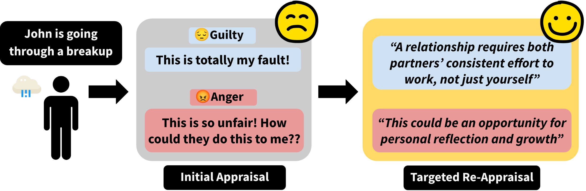

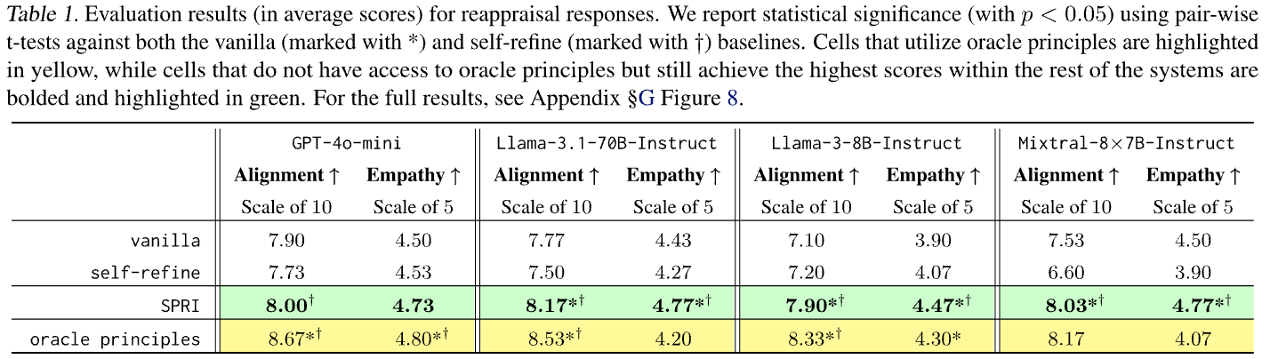
Evaluation of SPRI: Task 1
Producing
Cognitive Reappraisals
(Zhan et al., COLM 2024)
SPRI consistently outperforms methods that lack access to oracle principles both in terms of reappraisal alignment and perceived empathy
Zhan, H., et al. (2024). Large Language Models Are Capable of Offering Cognitive Reappraisal, if Guided. In Proceedings of the 1st Conference on Language Modeling (COLM).
Notes:
We evaluate SPRI in three situations. First, we consider a domain-specific task where expert-level complex principles were shown to be necessary in a prior work: having LLMs produce cognitive reappraisals. Cognitive reappraisals is a strategy widely recognized by psychology practitioners that aims to promote long-term mental wellbeing for an individual, and recent work showed that complex principles crafted by professional psychologists used in LLM prompts enables the models to perform this complex task.
This is an ideal testbed for SPRI to dynamically generate complex context-specific principles to guide the elicitation of reappraisal responses. By developing a unique set of principles from scratch for each individual user query, we show that SPRI consistently outperforms methods that lack access to oracle principles, and achieves performance comparable to those guided by oracle principles while minimizing human supervision.

Slide 5
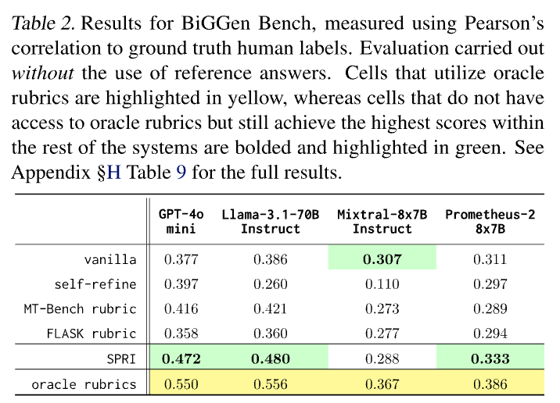
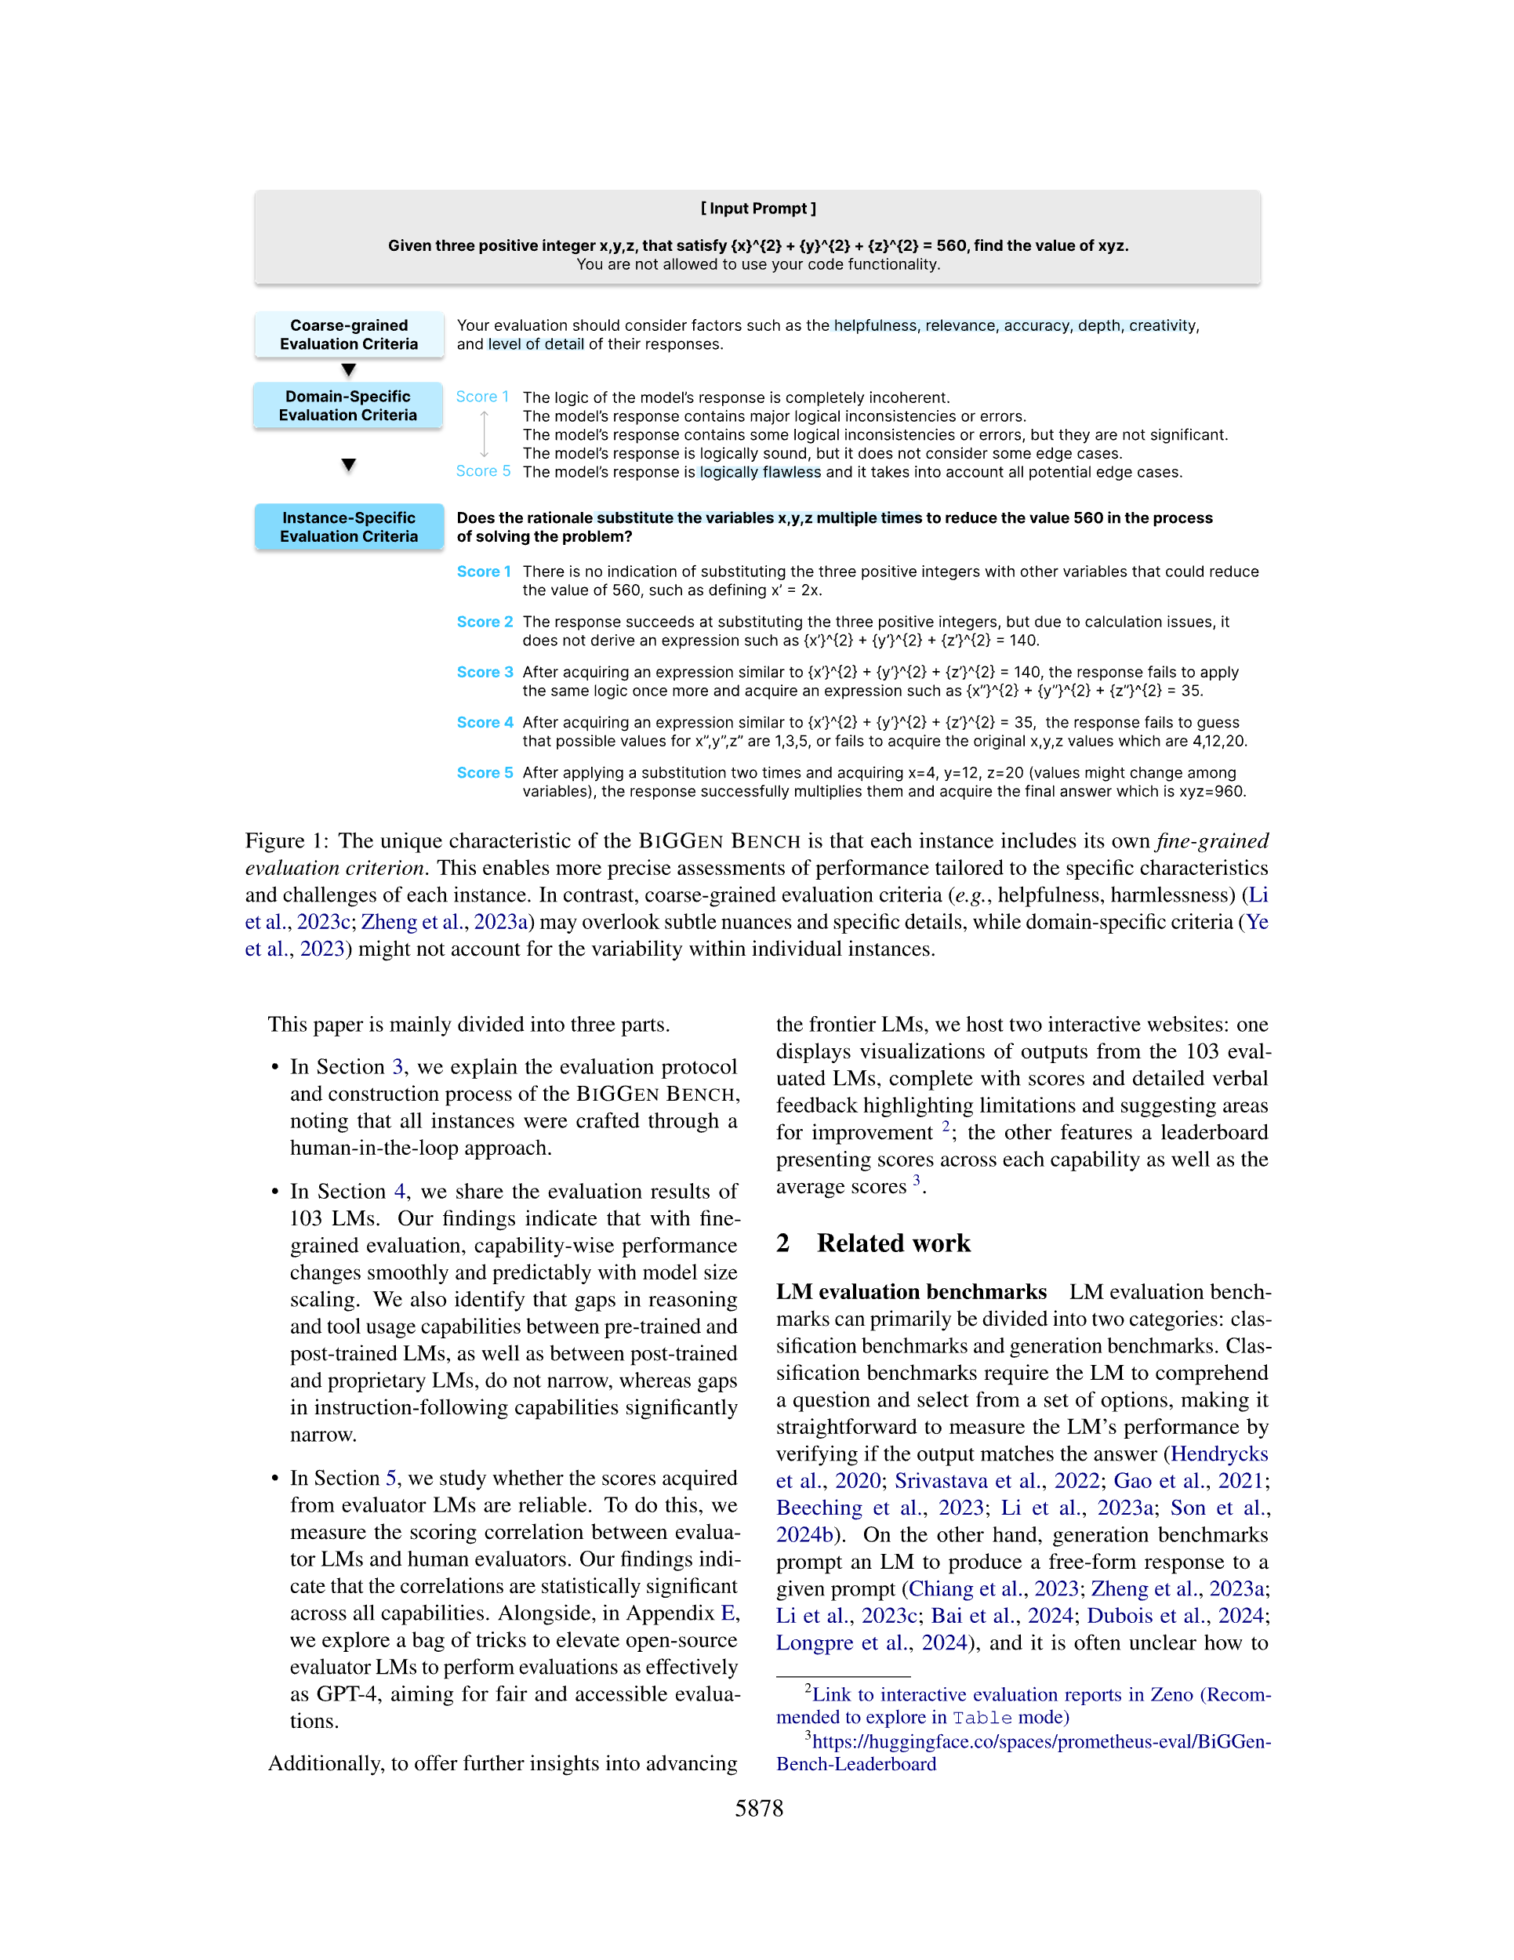
Evaluation of SPRI: Task 2
Generating
Instance-Specific Rubrics for LLM-as-a-Judge
(Kim et al., NAACL 2025)
Notably, SPRI outperforms the best-performing MT-Bench instance-agnostic baseline by an average of 12.1%
Kim, S., et al. (2025) The Biggen Bench: A Principled Benchmark For Fine-grained Evaluation of Language Models With Language Models. In Proceedings of NAACL 2025.
Notes:
Next, we consider a large benchmark where manually curated situation-specific rubrics are necessary: The Biggen Bench. It is an extensive benchmark designed to assess the performance of LLMs across a variety of tasks using language models, and it stands out due to its use of instance-specific evaluation rubrics, each meticulously curated to ensure detailed and contextually rich assessments. While these human-crafted criteria allow for a fine-grained analysis of models’ performance on each individual case, the manual creation of such detailed rubrics is both labor-intensive and time-consuming. We therefore propose leveraging SPRI to automate the rubric generation process.
Results show that LLMs, when guided by SPRI, can produce evaluation rubrics from scratch that align closely with human-annotated ones in quality and contextual specificity for each individual evaluation instance. Notably, LLM-judges evaluated on SPRI-generated rubrics outperform the best-performing MT-Bench Instance-agnostic baseline by an average of 12.1%.

Slide 6
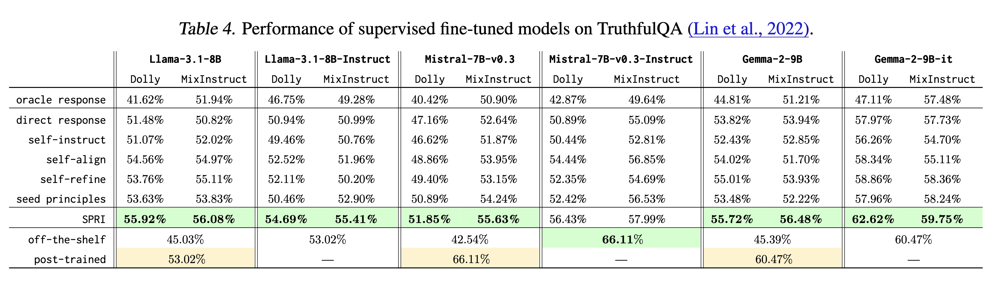
Evaluation of SPRI: Task 3
Using SPRI to generate large-scale synthetic alignment data for SFT
Generating synthetic data with SPRI proves effective for fine-tuning base LLMs, resulting in substantial improvement on TruthfulQA (Lin et al., 2022), whilst maintaining performance on other benchmarks (see the paper for details)
Notes:
Finally, we apply SPRI to a more general setting: generating large-scale synthetic data for supervised fine-tuning. Through evaluating language models fine-tuned on our synthetically generated data, we indirectly assess the capability of SPRI. Results show that generating synthetic data with SPRI proves effective for fine-tuning base LLMs, resulting in substantial improvement on TruthfulQA (Lin et al., 2022), whilst maintaining performance on other benchmarks (see the paper for details).

Slide 7
Thank you!

